Slide 1
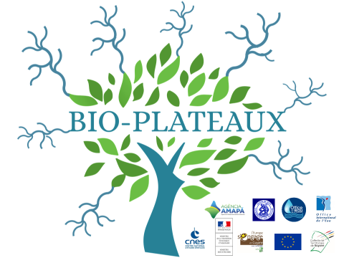

The Suriname Water Resources Information System
Dr. R. Nurmohamed
– 26 Nov. 2019 - Cayenne

Slide 2
Water Resources Information System of Suriname

Slide 3




Water management (left MR)
Current state MR:
A lot of people live in this basin,
Different economic activities e.g. wood, mining,
Poor observation network (~ 1986),
No hydro-meteorological studies,
Extreme events e.g. floods,
Conflicts e.g. border river south,
Insufficient to no water laws in place,
So, no WRM management from SUR site.

Slide 4
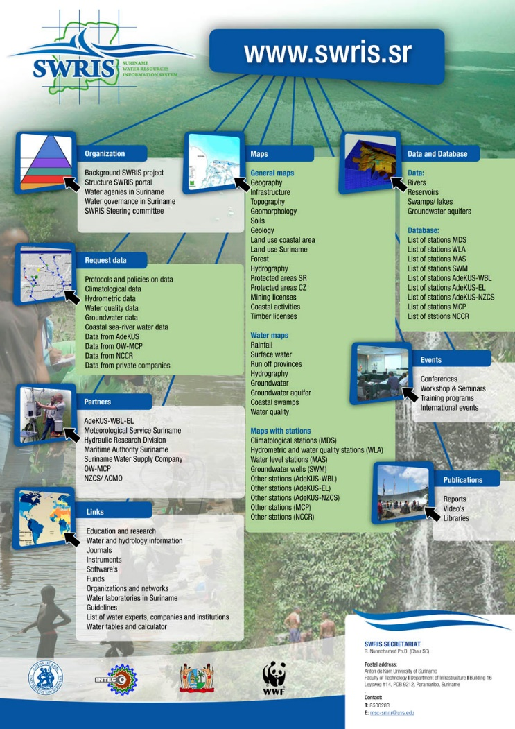
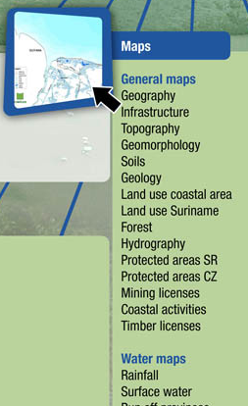
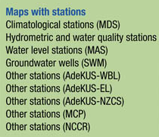

Slide 5
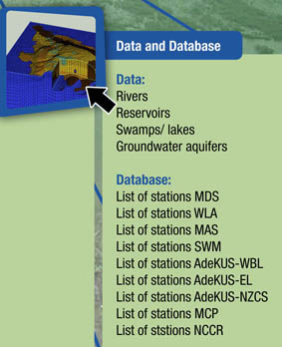
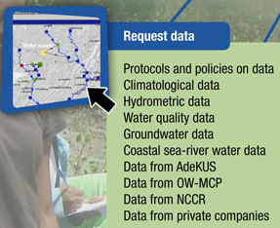
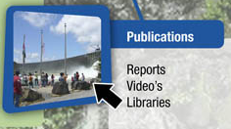

Slide 6
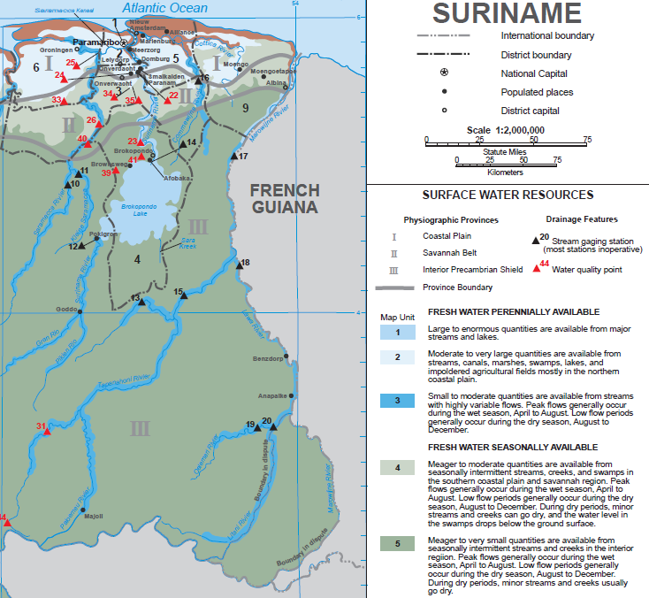
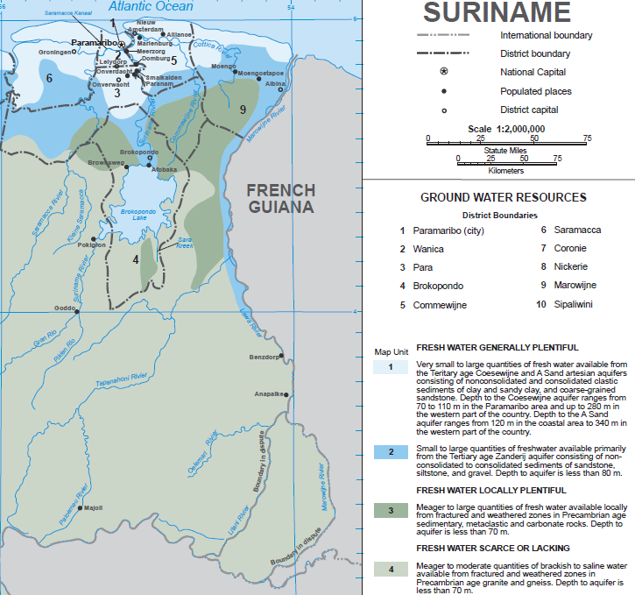

Slide 7
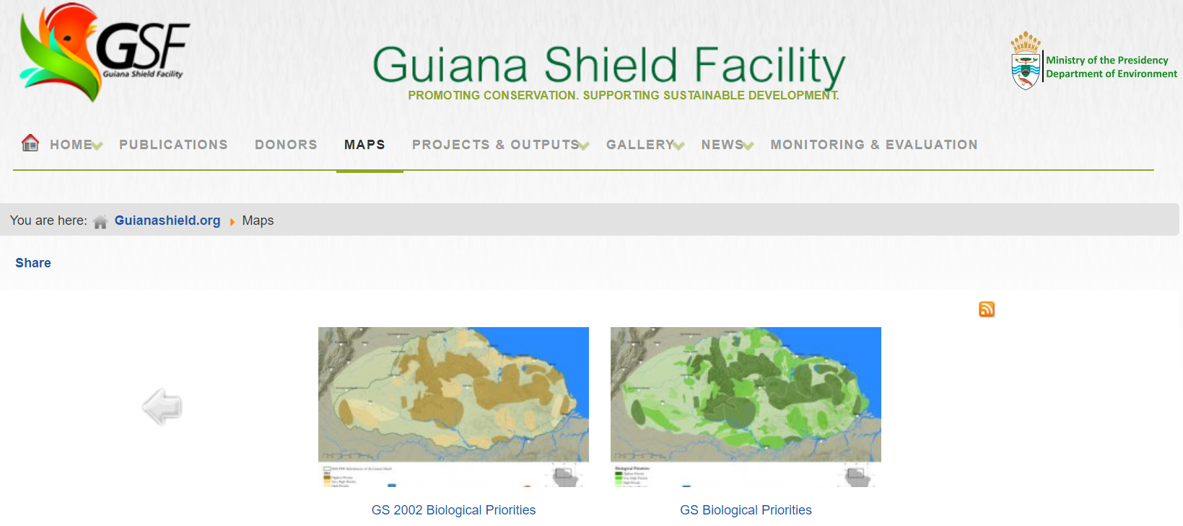
https://www.guianashield.org/index.php/maps

Slide 8
Future state MR:
Application of WRM:
    more observations,
    more modeling,
    specific laws,
    capacity building e.g. technology transfer
Integrated WRM database e.g. SWRIS
Better water resources management of MR e.g. environment, clean waters, healthy people,

Slide 9
Biodiversity Information of Suriname

Slide 10
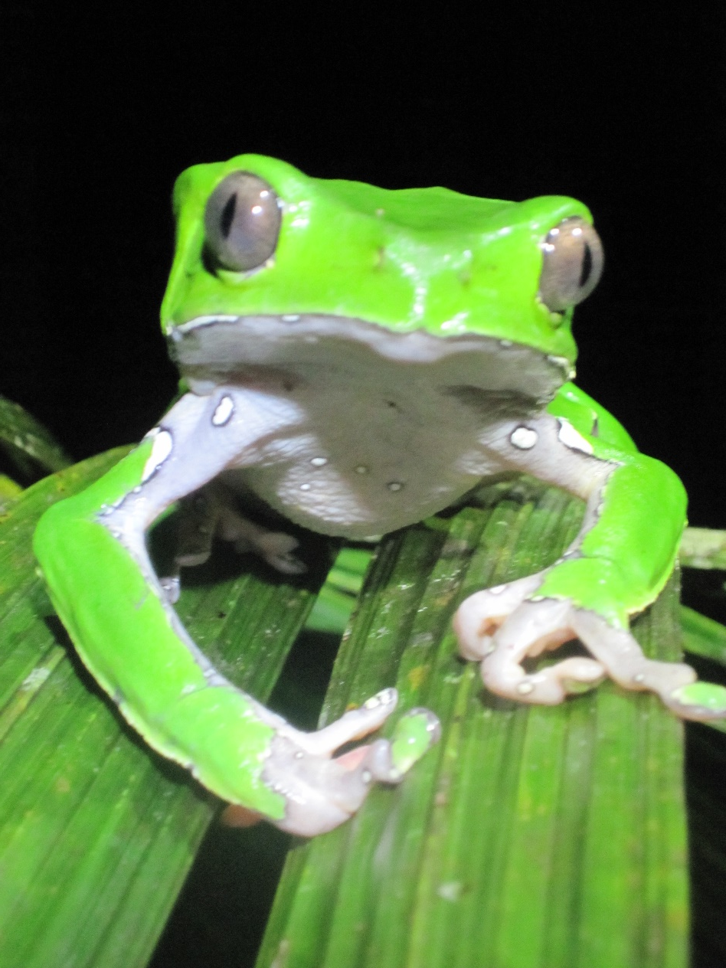

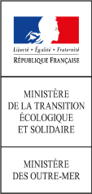




Biodiversity Information of Suriname
U. Satnarain
– 26 Nov. 2019 - Cayenne

Slide 11
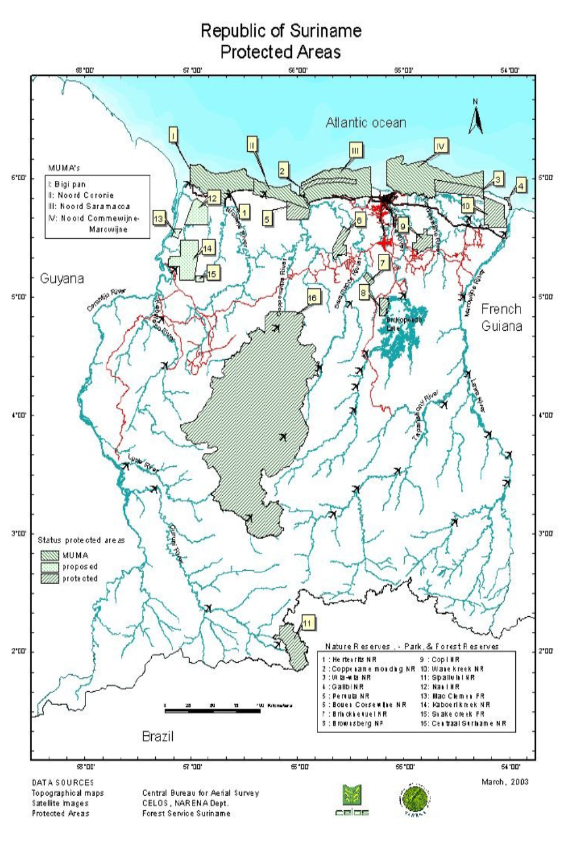
North Commewijne-Marowijne MUMA
Wia Wia NR
Galibi NR
Wane Creek

Slide 12
Biodiversity in Marowijne River Basin Area
Current Status Biodiversity Data and information
Important Ecosystem Services
Insufficient biodiversity data →$$$
Mangrove forest cover research by SBB
Endemic species
Various anthropological activities e.g. mining, logging, climate change, etc.

Slide 13
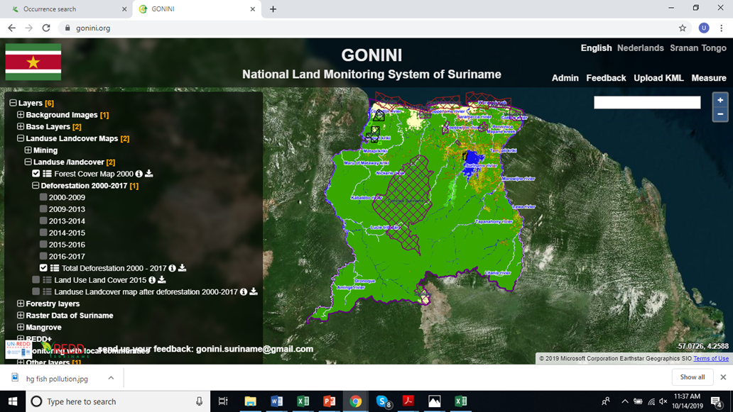
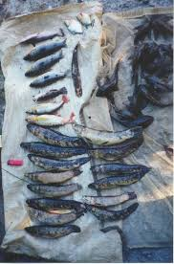
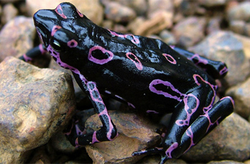
Threats
Uncontrolled mining, logging
Poaching
Impact of climate change
Lack/insufficient waste management

Slide 14
Needs
Awareness
Capacity building
Investment Human resources
Law Enforcement
Community Engagement
Political will
Regional/International Cooperation
List of laws and conventions
Nature Protection Law 1954
Hindrance Act G.B. 1930 no 64 amended by S.B.2001 no. 63
Police Criminal Law G.B. 1915 no 77 amended by S.B.1990 no. 24
Penal Code G.B.1911 no1 as amended
Forest Management Law
Pesticides Law
Law on Protection of Fish stocks
Mining Law
Petroleum Law
Draft Coastal Management Law
Law Maritime Zones
More...
Notes:
The current Nature Protection Law no longer meets the current demands to the challenges associated with nature conservation. Transparent procedures and criteria to establish protected areas are lacking, stakeholder involvement and legal protection are not regulated, and environmental impact reporting is not mandatory WWF Guianas and CIS initiated the project Onze natuur op 1 to revise the Nature Protection Law

Slide 15
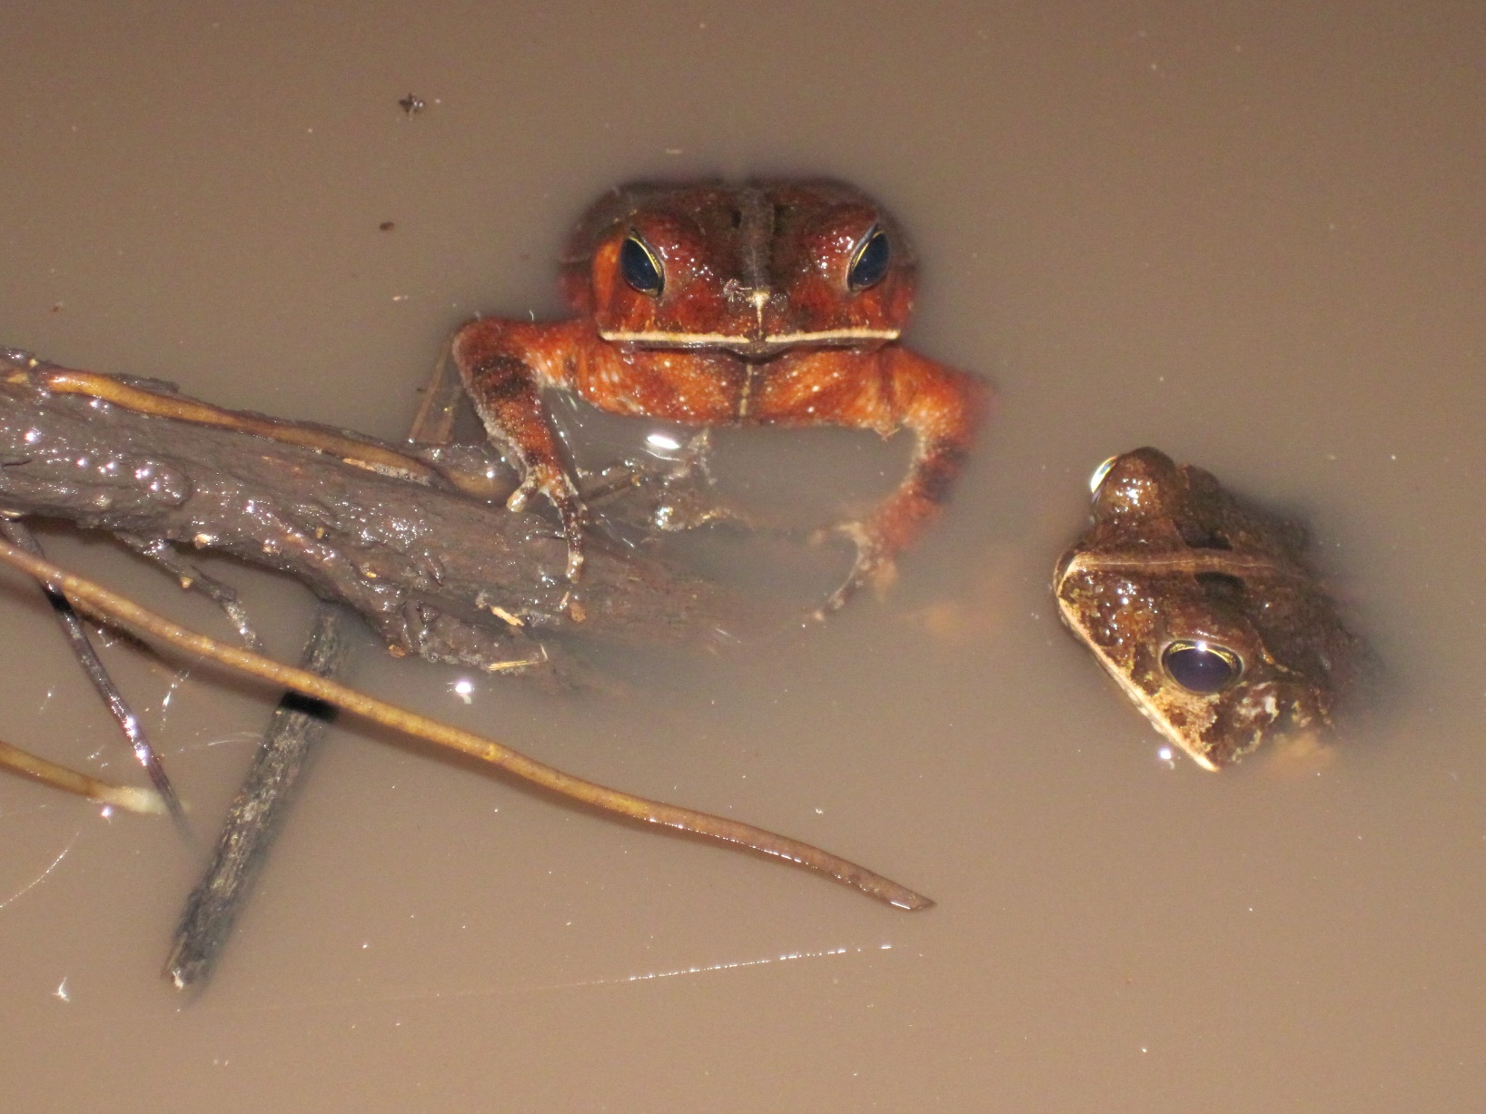
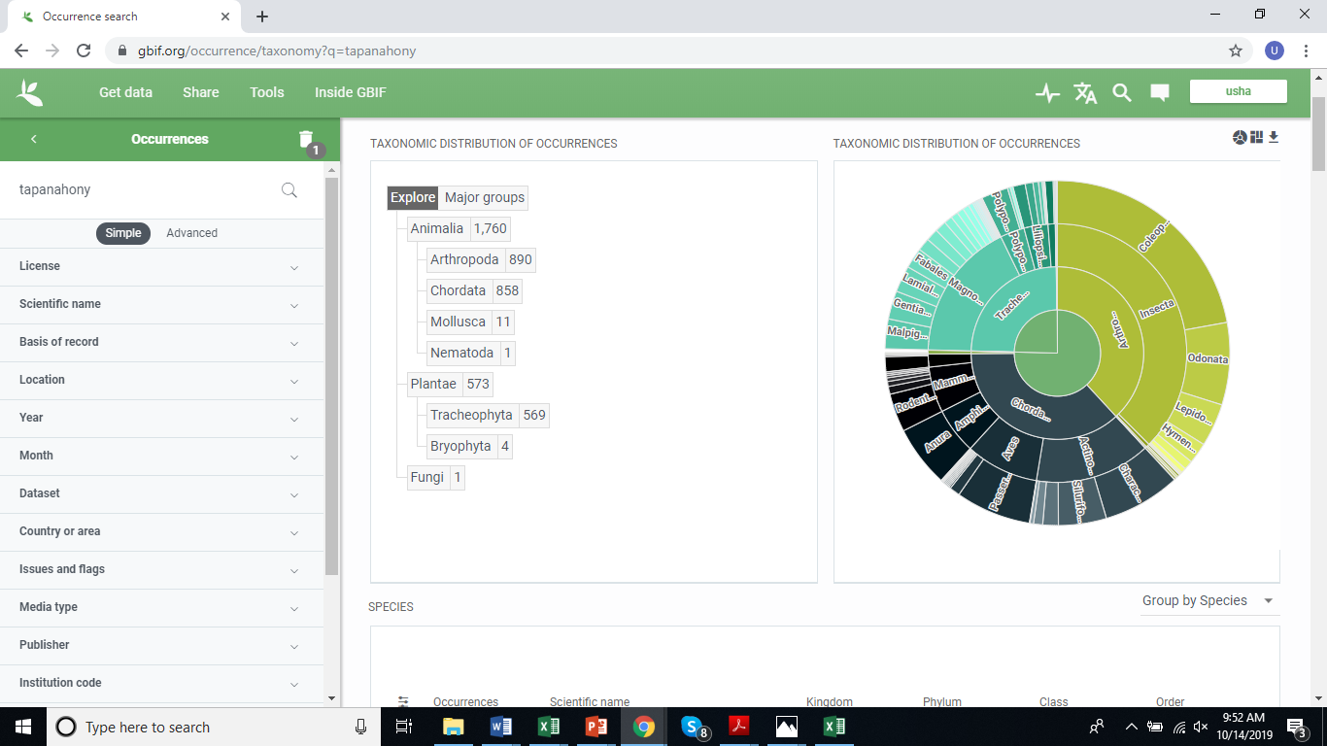
List of conventions
United Nations Convention on Biological Diversity
(CBD)
Convention on the Prevention of Marine Pollution by Dumping of Wastes and Other Matter (the "London Convention")
Rotterdam Convention on the Prior Informed Consent Procedure for Certain Hazardous Chemicals and Pesticides in International Trade
Basel Convention on the Control on the Transboundary Movement of Hazardous Waste and their Disposal
The Stockholm Convention on Persistent Organic Pollutants (POPs)
Paris Agreement
Remerciements
Ce support a été réalisé avec le soutien financier de l’Union Européenne.
Les opinions qu’il comporte n’engagent que sont auteur et ne reflètent pas nécessairement la position de l’Union Européenne.

