Slide 1











Hydrologic monitoring: Impact modelling & Climate Resilience
P. Donk & F.Kosso
– 26 Nov. 2019 - Cayenne

Slide 2
Hydrologic Monitoring:
(Impact) modelling & Climate resilience

Slide 3


Monitoring
Monitoring: Gauging networks
  MET Stations (Precipitation, Evaporation, Temperature)
  Hydraulic stations (River discharge)

Slide 4
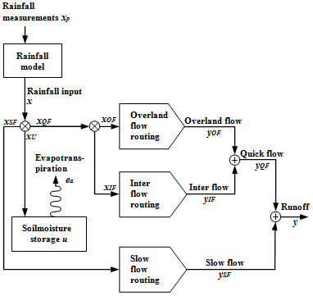
Hydrologic Modelling
Hydrologic modelling
  VHMbuild: Generalized Conceptual Model
  Parsimonious approach (Simplest effectively/efficiently fitting the purpose of application)
  Stepwise data mining based (sub)model structure identification & calibration procedure (=>high performance)
P
VHM HYDROLOGICAL MODEL
QUICK FLOW
ETo
DISCHARGE
STORAGE

Slide 5
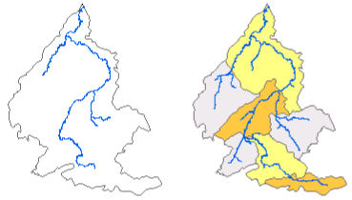
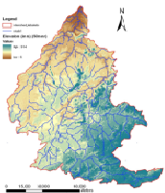
Hydrologic Modelling
Lumped conceptual => Sub-cathments => Watershed delineation (ArcGIS/ ArcMap/ QGIS)
P
VHM HYDROLOGICAL MODEL
QUICK FLOW
ETo
DISCHARGE
STORAGE

Slide 6
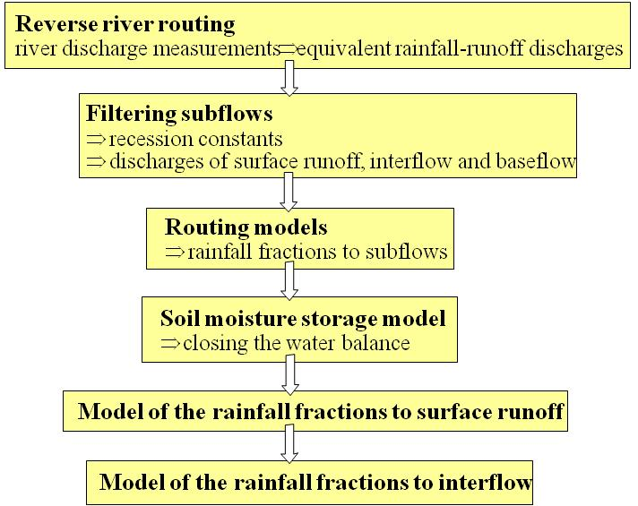
Time Series processing/ analysis
WETSPRO
  WETSPRO: Water Engineering Time Series PROcessing Tool
  Supporting tool for VHM Model
  Stepwise (sub)model structure identification & calibration procedure

Slide 7
Time Series processing/ analysis
WETSPRO
  WETSPRO: Water Engineering Time Series PROcessing Tool
  Extreme value distribution analysis
For example low flows:
Consideration of the duration of the low flow or drought period
→ discharge/duration/frequency relationships
→ considering different durations relevant for the several applications:
  irrigation
  hydropower plants
  domestic supply
  pollution

Slide 8
Climate modelling:
Climate Change Impact Assessments
Observed data
(pre-)processing
Climate modeling
Hydrologic modelling
Downscaling climate change scenarios
Hydrologic response simulations/ river discharge
Analyzing climate change impacts
on water resources

Slide 9
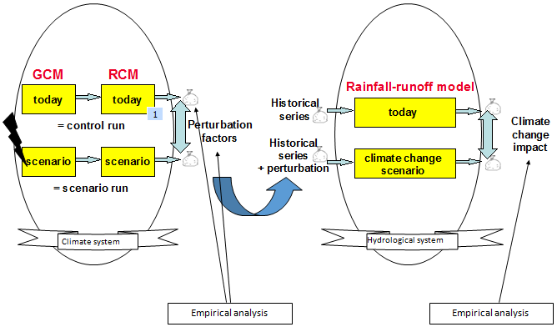
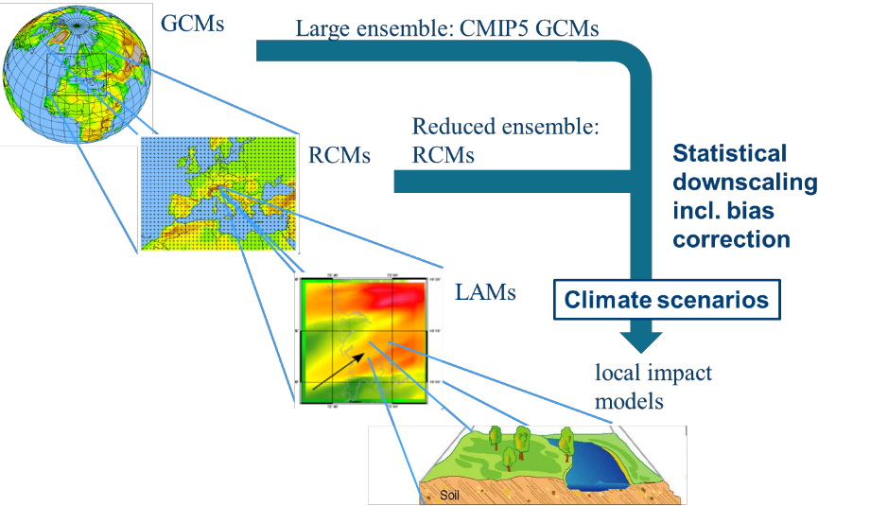
Climate modelling:
Climate Change Impact Assessments
Climate Perturbation Tool
(Statistical Downscaling of climate model outputs e.g. CMIP5)
  Precipitation
  Temperature
  Evaporation
  Wind

Slide 10
Case study: Application to Suriname river basin/
Hydropower future impact assessments

Slide 11
Case study: Application to Suriname Riverbasin/
Hydropower future impact assessments
Observed data
(pre-)processing
P
Climate modeling
Hydrologic modelling
QUICK FLOW
Downscaling climate change scenarios
Hydrologic response simulations/ river discharge
DISCHARGE (FDC)
ETo
Analyzing climate change impacts on water resources, hence hydropower potential
STORAGE
BASE FLOW

Slide 12
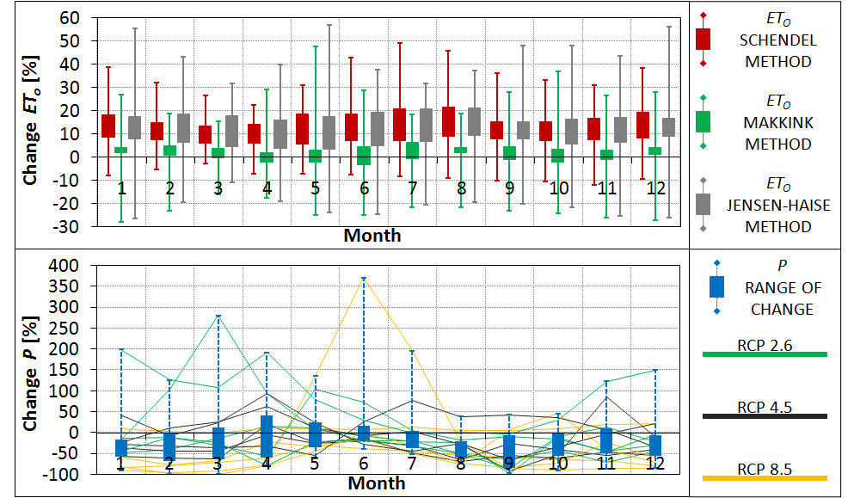
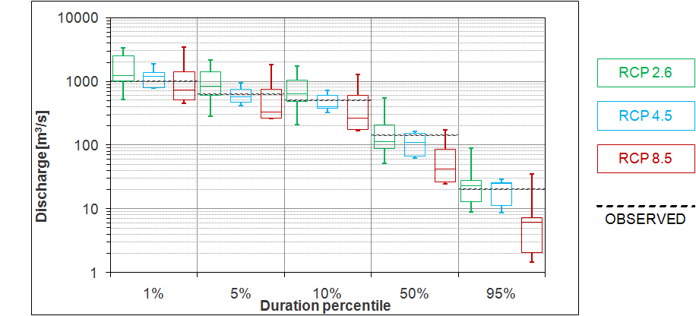
Case study: Application to Suriname river basin/
Hydropower future impact assessments
UPPER SURINAME RIVER BASIN: DISCHARGE PROJECTIONS BY 2070-2100

Slide 13
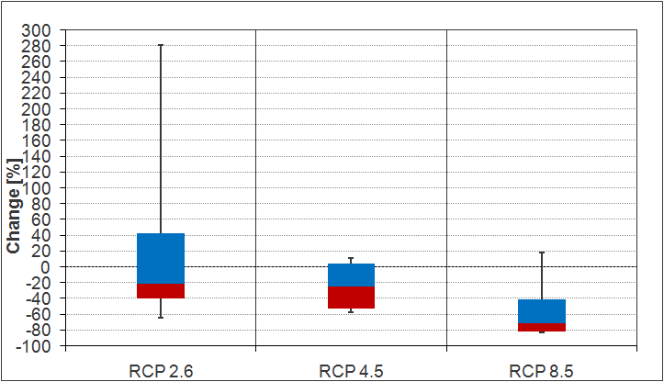
Case study: Application to Suriname river basin/
Hydropower future impact assessments
UPPER SURINAME RIVER BASIN: HYDROPOWER POTENTIAL PROJECTIONS BY 2070-2100

Slide 14
Website
https://www.kuleuven.be/hydr/pwtools.htm

Slide 15
Hydro-BID
Simulation tool created by IDB to support the management and planning of water resources use in Latin America and the Caribbean (LAC)
A system for integrated, quantitative simulation of hydrology and climate change for assessing the potential impacts of climate change on water flows and infrastructure and supporting the design of adaptive projects and strategies

Slide 16
Hydro-BID: Components
Analytical Hydrography Dataset (AHD)
-Catchments and Stream network
Data input
-Precipitation , Temperature and Discharge
Hydrology Model

Slide 17
Hydro-BID: Software
HydroBID from RTI international
Java Program to run climate interpolation and perform simulation
Sqlite Browser to view data of catchments: parameters, area, landuse, climate data
QGIS to view catchments and streams, to navigate, to identify waterside outlet COMID
Ms Excel to covert all sheet in CSV format

Slide 18
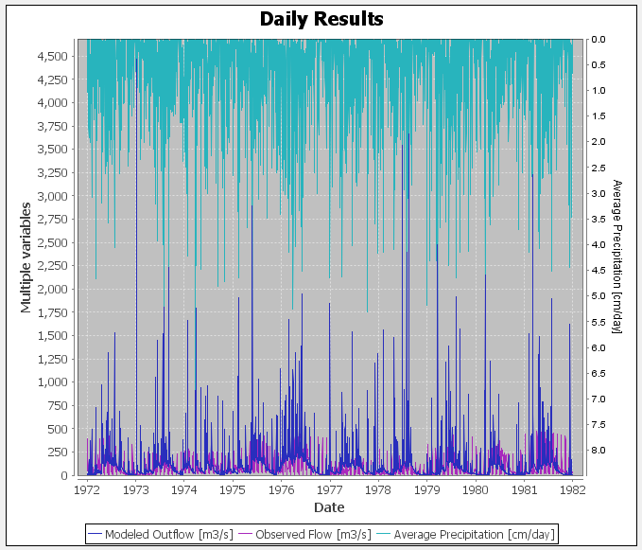
Hydro-BID: Results after calibration

Slide 19
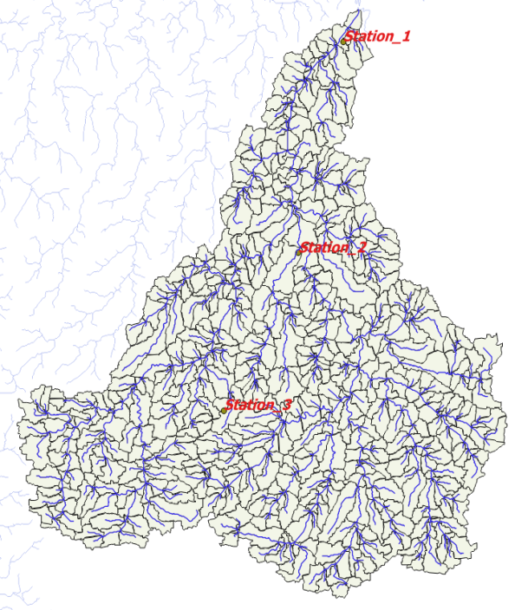
Hydro-BID: Marouni basin
Catchment Outlet COMID: 30116800
Total Catchment upstream : 663
Total drainage Area : 65781.27 sq km
Total stream segment length : 65781 km

Slide 20


Remerciements
Ce support a été réalisé avec le soutien financier de l’Union Européenne.
Les opinions qu’il comporte n’engagent que sont auteur et ne reflètent pas nécessairement la position de l’Union Européenne.

