Slide 1


Water pollution MRB
Usha Satnarain MSc.
– 26 Nov. 2019 - Cayenne

Slide 2
Water Pollution of the Marowijne RiverBasin

Slide 3




Potential Pollution Sources
Main activities with possible effects on MRB :
Communities living in this basin → daily activities
Various economic activities e.g. timber, mining
Extreme weather events e.g. floods
Lack of waste management
Climate change

Slide 4
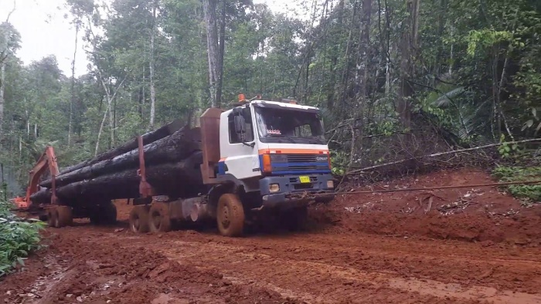
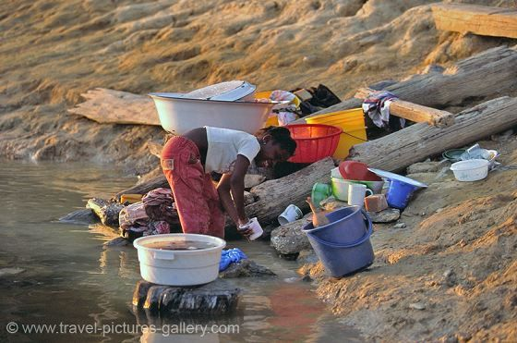
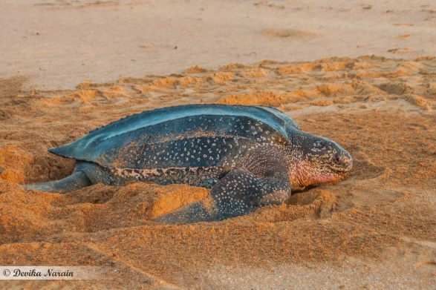
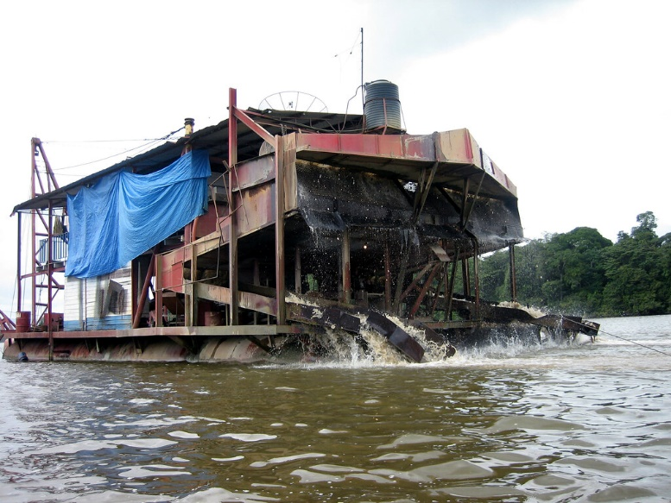
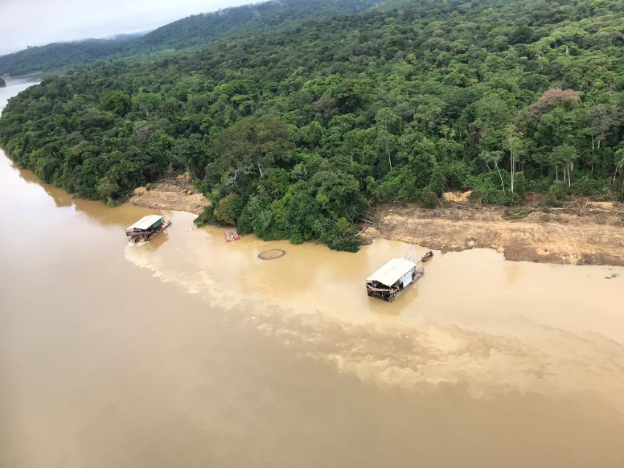
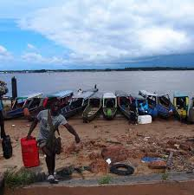
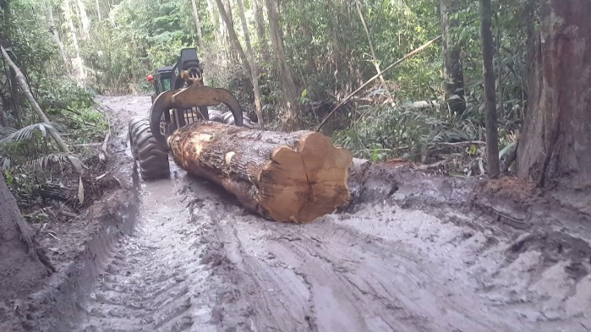
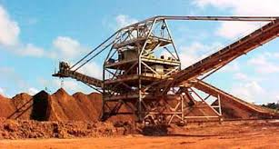
Possible effects
Mining (gold)
Logging
construction of road networks, such as logging roads, skid trails, and log yards for extraction and transportation of timber
severity is determined by variety of factors: slope, harvest type, harvest equipment used, weather conditions during and after harvest, use of BMPs, and many others.
Daily activities

Slide 5
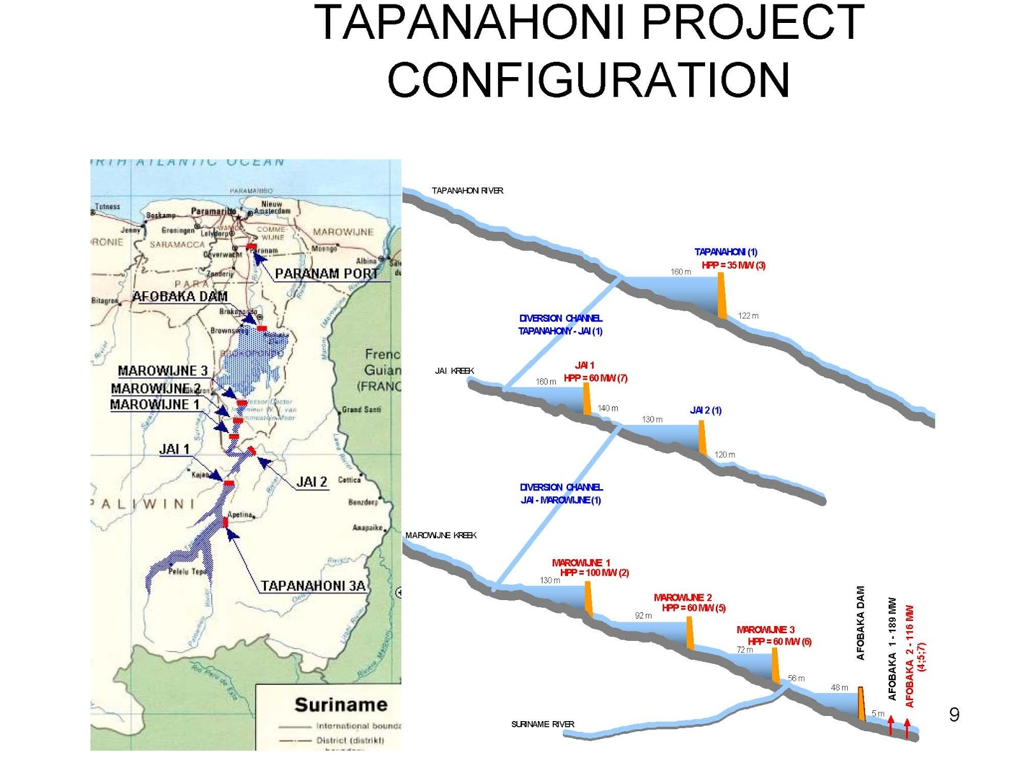
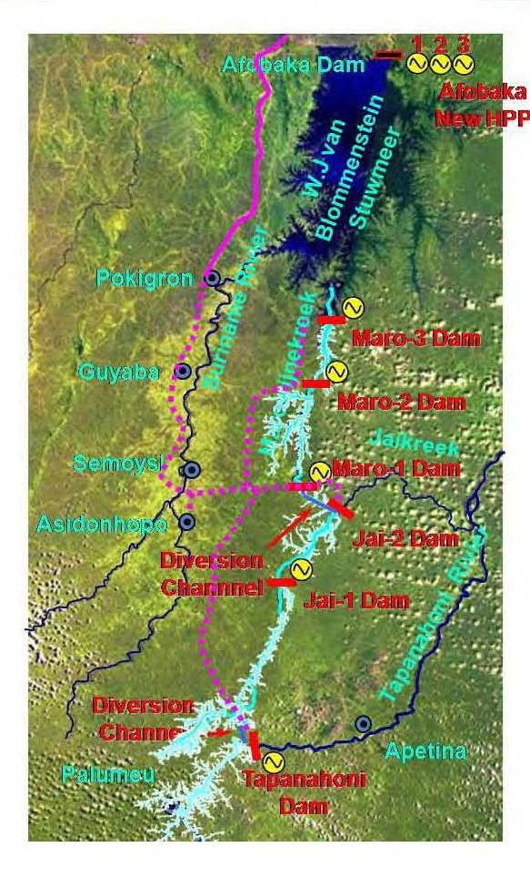
Possible effects
Tapajai project

Slide 6
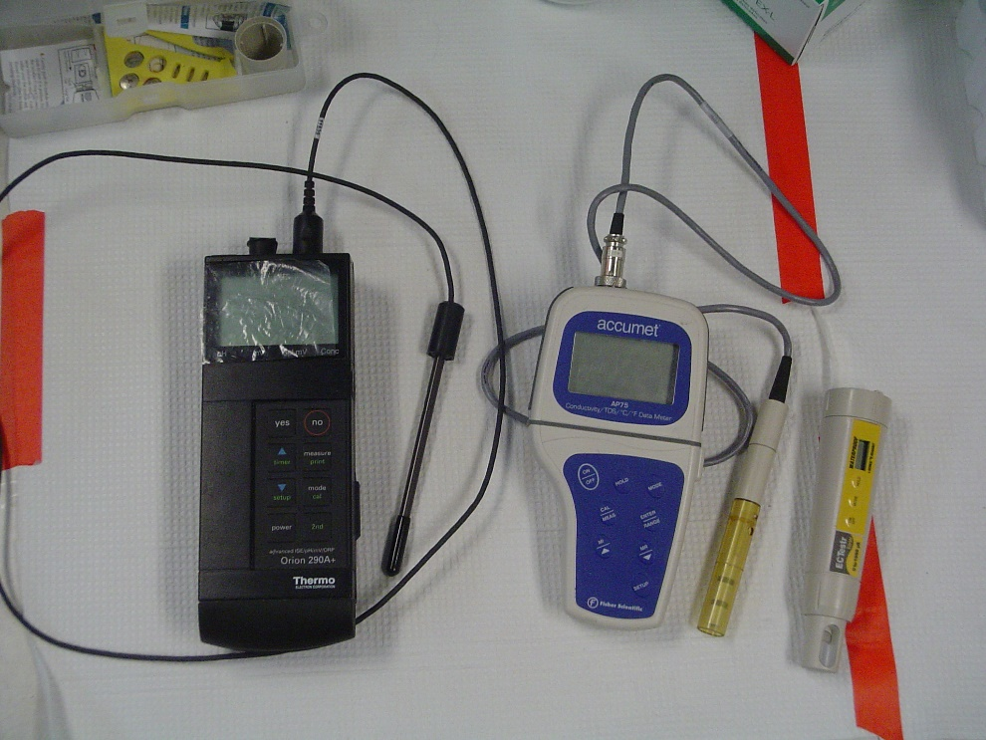
Current State
Water quality measurements
Aquatic Biodiversity

Slide 7
Future state MRB:
Remote sensing (high resolution satellite image)
    Better understand MRB
    Identification research stations (monitoring)
Integrated biodiversity database including water quality monitoring
Capacity building e.g. technology transfer
Financial sources

Slide 8
Hydrological Data MRB

Slide 9
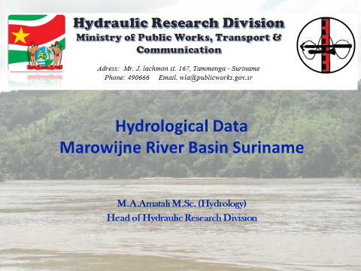






Amatalie
– 26 Nov. 2019 - Cayenne

Slide 10
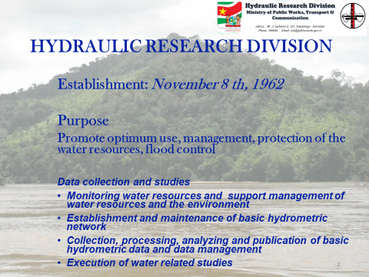

Slide 11
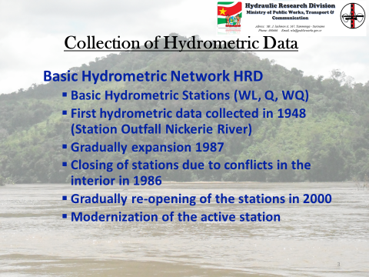

Slide 12
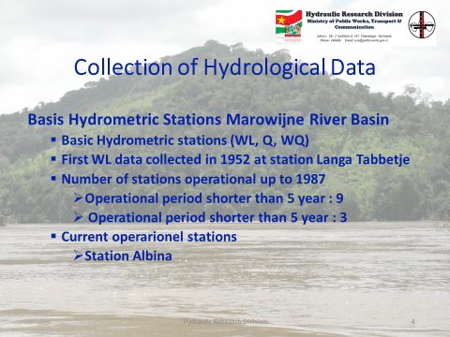

Slide 13
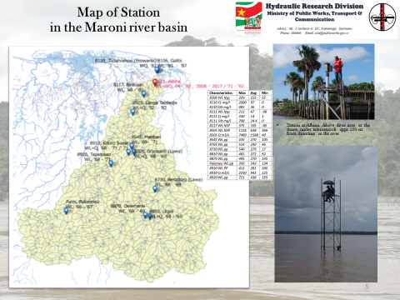

Slide 14
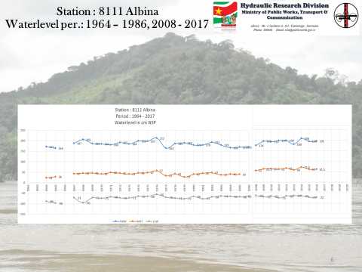

Slide 15
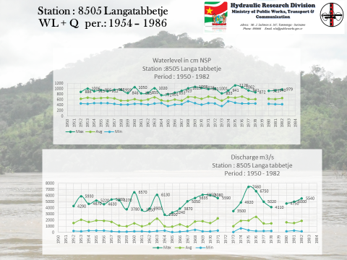

Slide 16
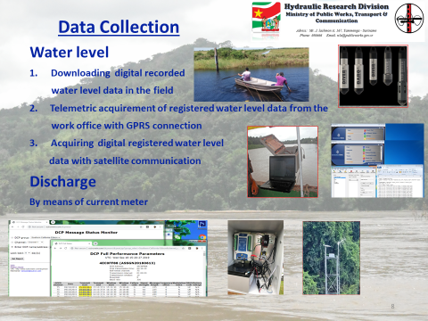
Remerciements
Ce support a été réalisé avec le soutien financier de l’Union Européenne.
Les opinions qu’il comporte n’engagent que sont auteur et ne reflètent pas nécessairement la position de l’Union Européenne.

